Slide 1

Optimizing ICU Management with Data Warehousing
Warehouse Wizards
Bhavesh Purohit
Kushal Modi
Simran Gandhi

Slide 2
Introduction
Intensive Care Units (ICUs) play a critical role in patient survival but managing ICU resources and predicting patient outcomes remain significant challenges.
The ICU Data Insights project leverages advanced data warehousing and analytics to extract meaningful patterns from ICU patient records.
Using the MIMIC-III Clinical Database CareVue subset, this project aims to develop a data-driven approach to enhance clinical decision-making, optimize ICU resource allocation, and improve patient care.

Slide 3
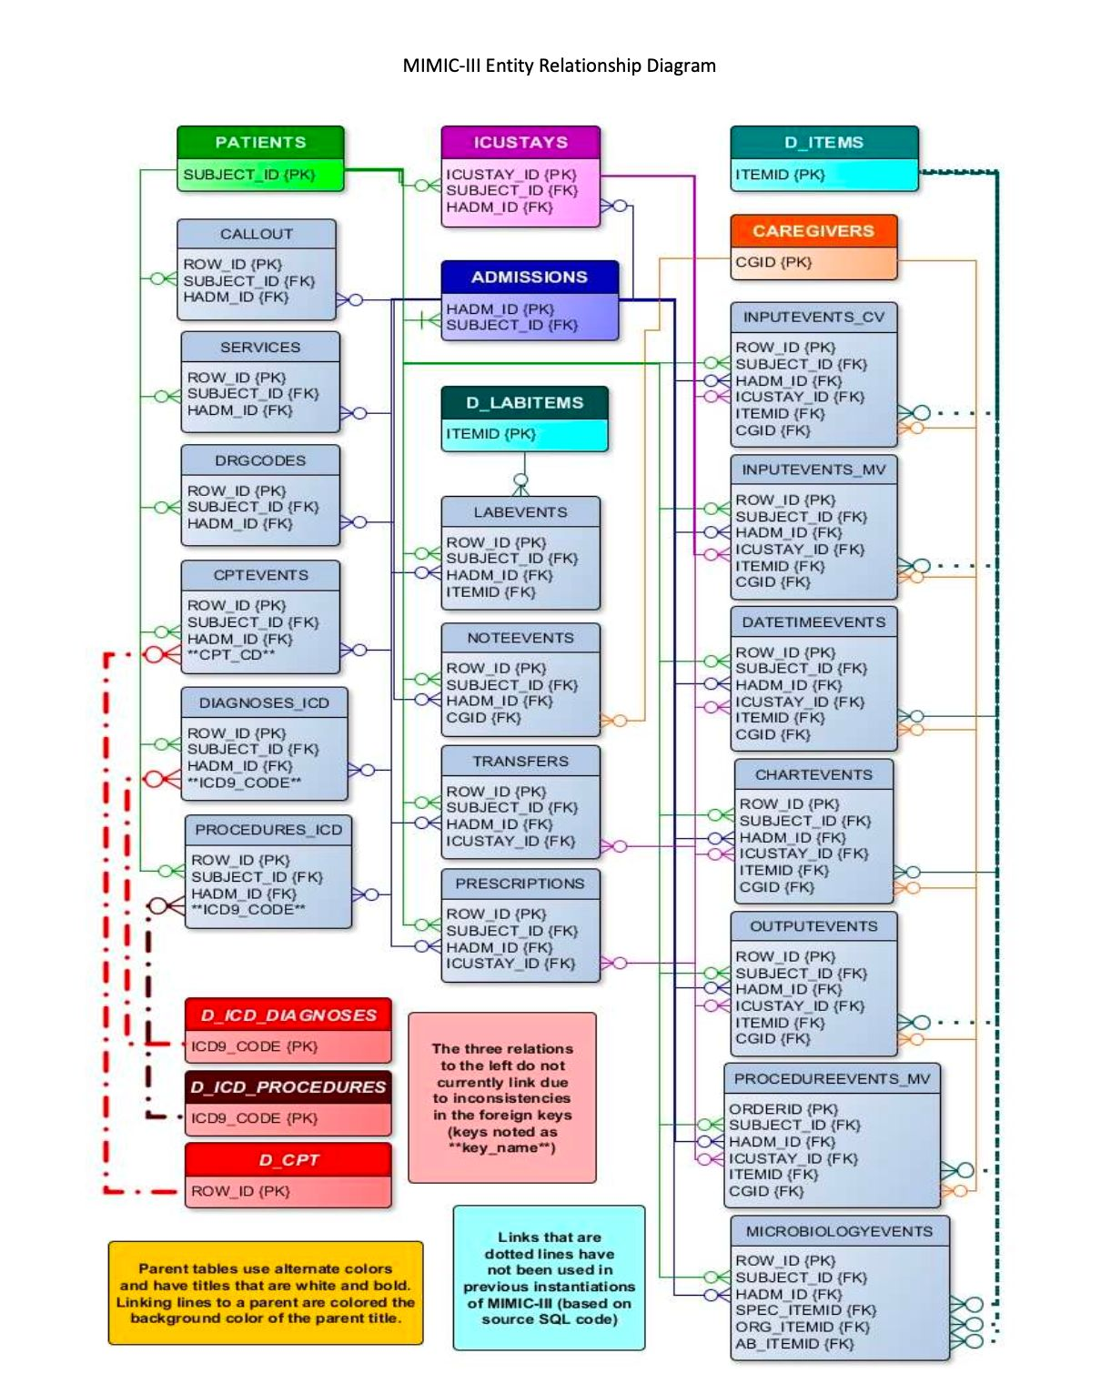
Database
Derived from the MIMIC-III Clinical Database (Medical Information Mart for Intensive Care), a publicly available critical care dataset from Beth Israel Deaconess Medical Center.
Contains millions of de-identified electronic health records of over 60,000 ICU admissions from 2001 to 2012.
Includes demographic, diagnostic, treatment, and outcomes data for adult ICU patients.

Slide 4
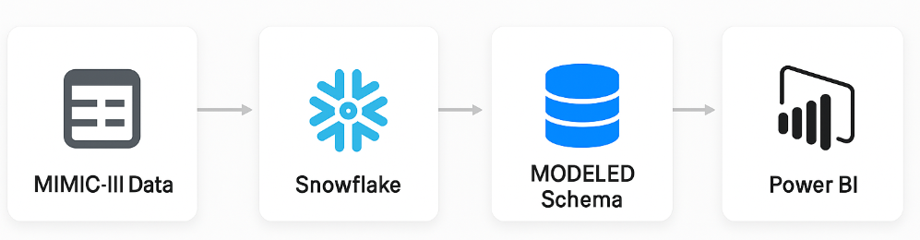
End-to-End Architecture & Workflow
Data Acquisition
Imported de-identified ICU and hospital records from the MIMIC-III dataset in CSV format.
Cloud Data Platform Setup (Snowflake)
Configured a dedicated Snowflake database with RAW, STAGE, and MODELED schemas to support ELT workflows.
File Ingestion & Staging
Uploaded raw CSVs to Snowflake internal stages and ingested them into RAW tables using COPY INTO
Data Transformation (ELT)
Performed in-Snowflake ELT to clean, join, enrich, and derive analytical fields like LOS, age, and readmission flags.
Power BI Integration
Connected Power BI to Snowflake's MODELED schema to pull curated data for visualization.
Visualization & Reporting
Created interactive visuals and KPI cards in Power BI for ICU trends, LOS analysis, patient demographics, and drug usage.

Slide 5
Data Transformation Highlights
Converted all raw timestamp fields (INTIME, OUTTIME, ADMITTIME, DISCHTIME) to standard formats and extracted useful parts (e.g., Day, Hour, Month).
Calculated ICU LOS (Length of Stay) in both hours and days using OUTTIME - INTIME, rounded for dashboard readability.
Derived patient age from DOB and ADMITTIME; applied bounding logic to cap at 89+ to comply with MIMIC de-identification standards.
Created categorical age groups (e.g., "0–17", "18–39", "40–64", "65+") to enable demographic breakdowns in visuals.
Imputed or filtered out records with missing key fields (GENDER, ICUSTAY_ID, HADM_ID, DRUG, ICU_LOS) to ensure visual consistency.
Unified medication names using DRUG_NAME_POE, DRUG_NAME_GENERIC, and GSN; standardized drug types for clean filtering.
Derived ICU readmission flag (ICU_READMISSION_FLAG) by identifying multiple ICU stays within a short timeframe for the same patient.

Slide 6
Bus Matrix
Business Process Case | ICU Stay Facts | Admissions | Patients | Medications | Time
ICU Utilization Analysis | ☑️ | ☑️ | ☑️ | ❌ | ☑️
Mortality & Outcome Tracking | ☑️ | ☑️ | ☑️ | ❌ | ☑️
Medication Usage Monitoring | ❌ | ☑️ | ☑️ | ☑️ | ☑️
Readmission Rate Analysis | ☑️ | ☑️ | ☑️ | ❌ | ☑️
Demographics & Risk Breakdown | ☑️ | ☑️ | ☑️ | ❌ | ☑️
Drug Prescribing Behavior | ❌ | ☑️ | ☑️ | ☑️ | ☑️
Care Unit Transfer Mapping | ☑️ | ☑️ | ☑️ | ❌ | ☑️

Slide 7

Business Processes
ICU Mortality & Length of Stay Analysis
Medication Usage and Administration Trends
Hospital Resource Utilization & Occupancy Analysis

Slide 8
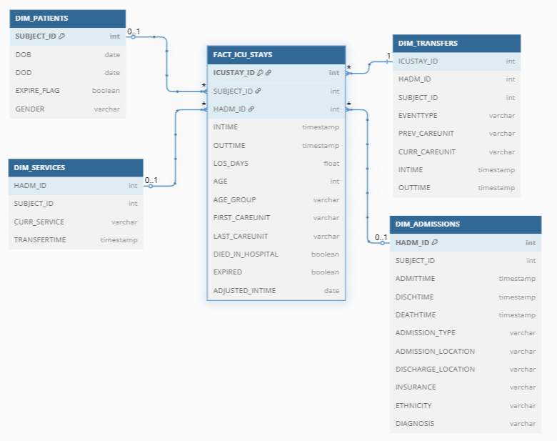
Schema for ICU Mortality & LOS Analysis

Slide 9
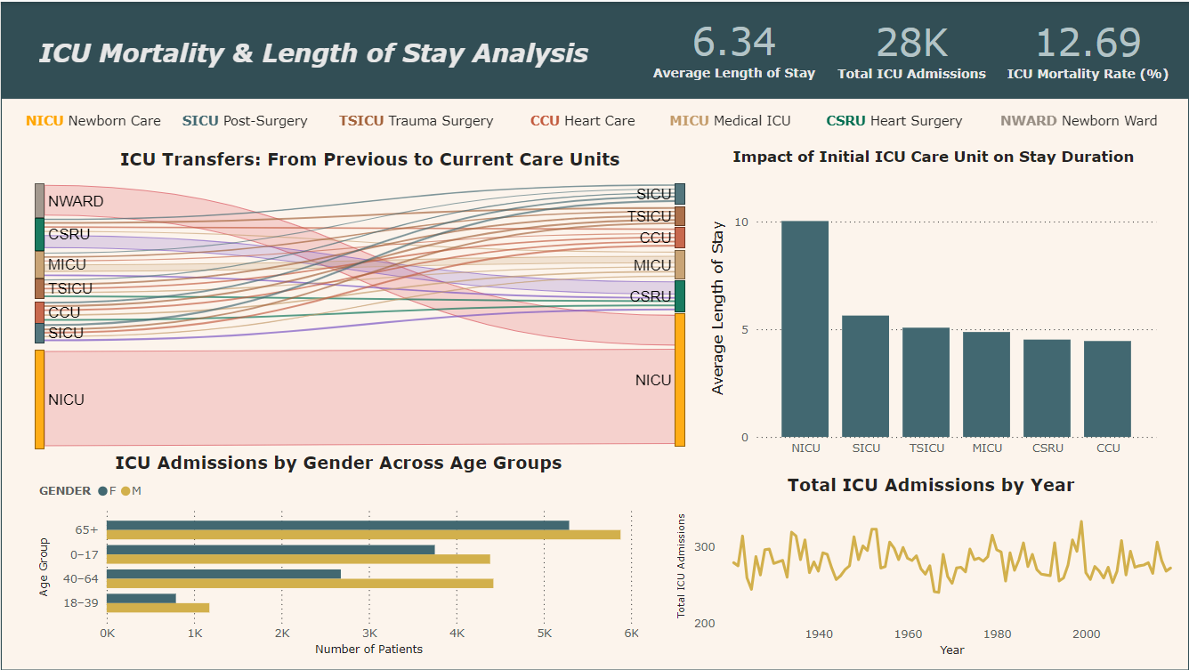

Slide 10
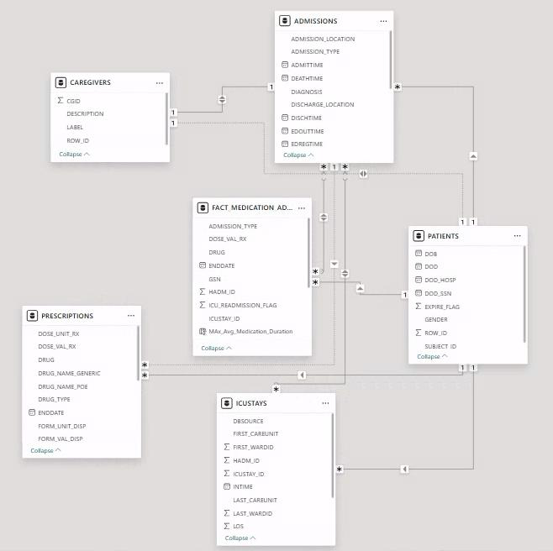
Schema for Medication Usage & Administration Tools

Slide 11
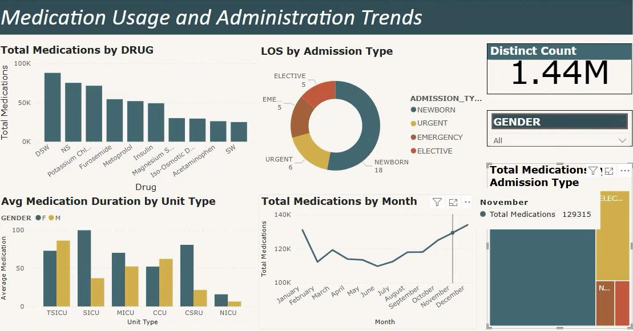

Slide 12
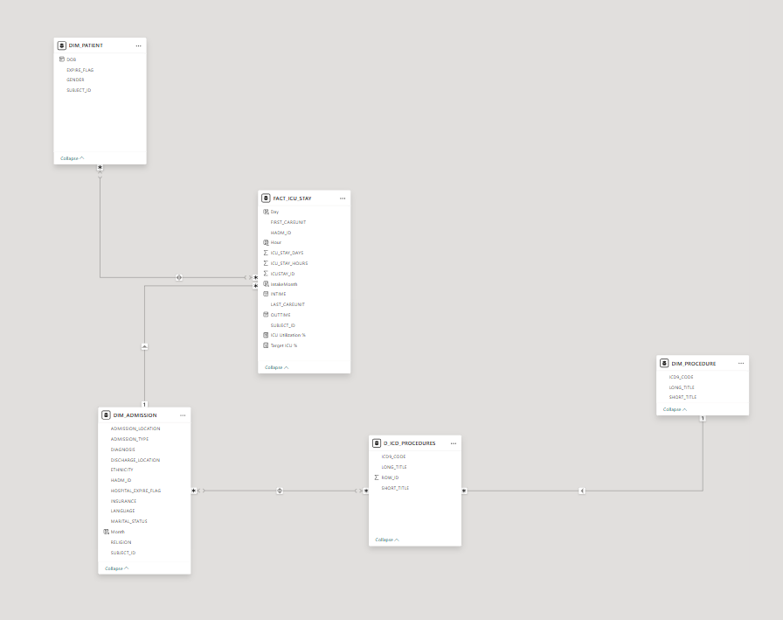
Schema for Hospital Resource Analysis

Slide 13
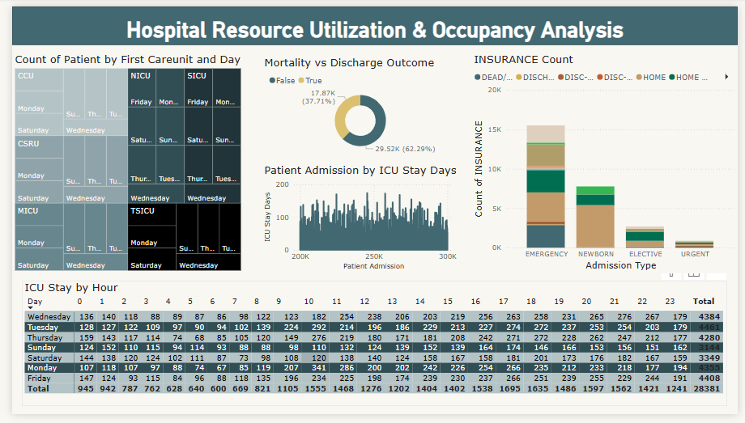

Slide 14
Why This Matters to Healthcare Organizations
1. Enhances Clinical Decision-Making
Provides frontline doctors and pharmacists with a clear view of medication patterns, helping them make faster, safer, and more informed decisions — especially for high-risk patients in critical care.
2. Supports Quality & Safety Monitoring
Helps hospitals proactively monitor high-risk drug usage, flag unusual prescription patterns, and identify connections between medications and extended ICU stays or readmissions.
3. Drives Operational Efficiency
Optimizes resource allocation by tracking drug volume, LOS trends, and ICU capacity usage — supporting better planning, scheduling, and medication inventory management.
4. Enables Evidence-Based Policy Development
Allows administrators and clinical leaders to create data-driven guidelines for medication administration, based on outcomes rather than assumptions.
5. Lays the Foundation for Predictive Healthcare
With structured historical data and clean pipelines, organizations can build future tools like readmission predictors, high-risk patient alerts, or AI-driven treatment suggestions.

Slide 15


